Slide 1
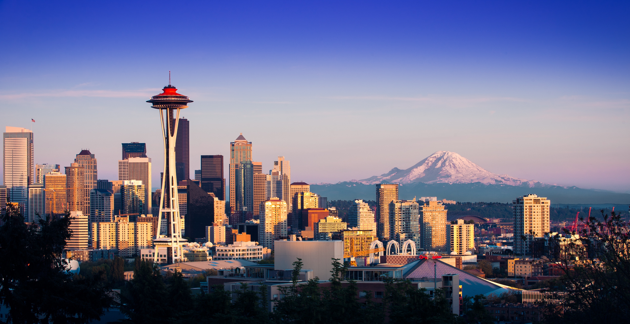
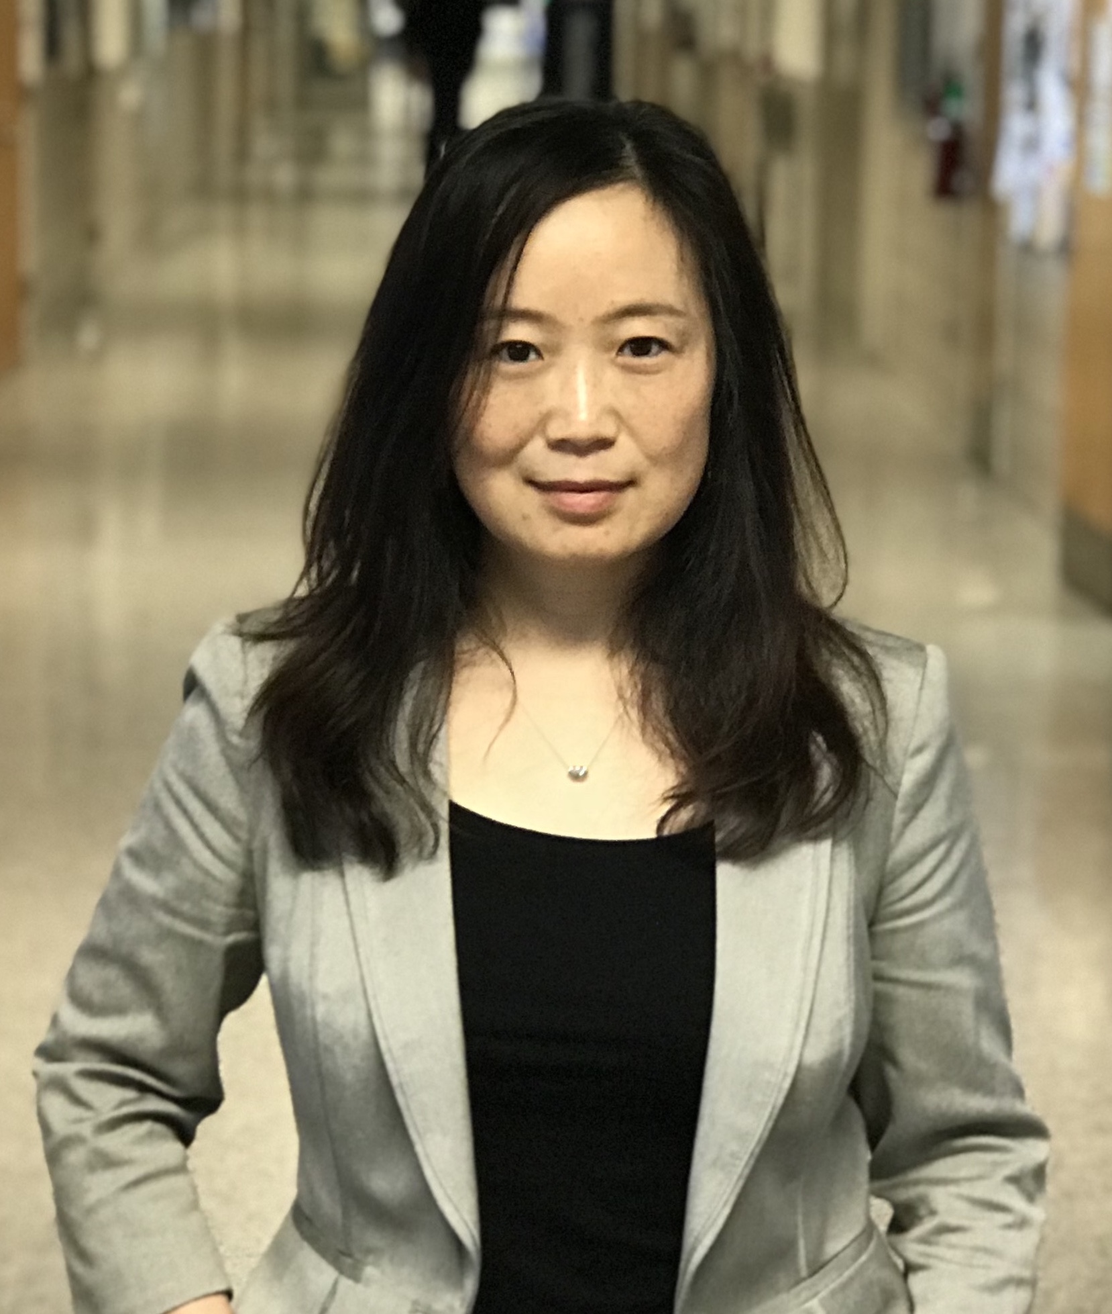
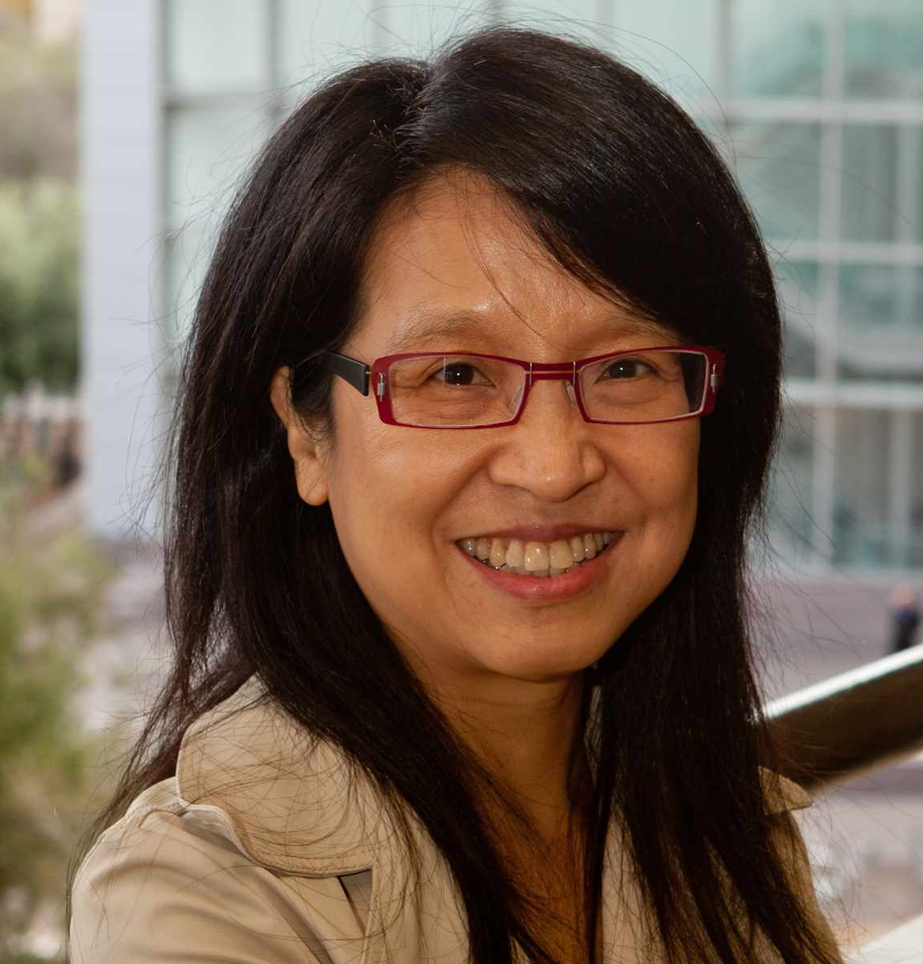
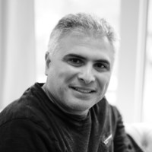
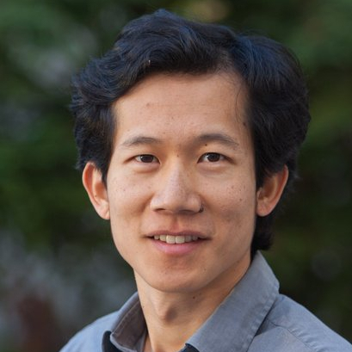
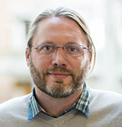
NLI 2020: First Workshop on Natural Language Interfaces
at ACL’20 in Seattle, United States, July 10, 2020
Call for Full / Short / Cross submissions (ddl: April 20)
Invited Speakers (more to add):
Joyce Chai
University of Michigan
Monica Lam
Stanford
Imed Zitouni
Google
Percy Liang
Stanford
Luke Zettlemoyer
UW & FAIR
For details, please check out: https://nli-acl2020.github.io/

Slide 2
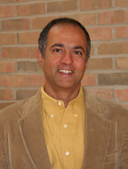
NLI 2020: First Workshop on Natural Language Interfaces
co-located with ACL’20, July 10, 2020
Invited Speakers:
Joyce Chai
University of Michigan
H V Jagadish
University of Michigan
Monica Lam
Stanford
Imed Zitouni
Google
Percy Liang
Stanford & Microsoft Semantic Machines
Luke Zettlemoyer
UW & FAIR
For details, please check out: https://nli-acl2020.github.io/

Slide 3
Joyce Chai
University of Michigan
H V Jagadish
University of Michigan
Monica Lam
Stanford University
Imed Zitouni
Google
Percy Liang
Stanford University
Microsoft Semantic Machines
Luke Zettlemoyer
University of Washington
Facebook AI Research

Slide 4
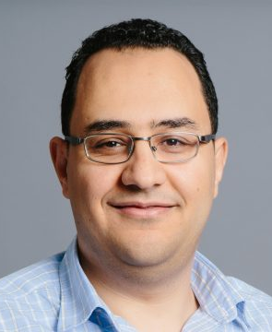
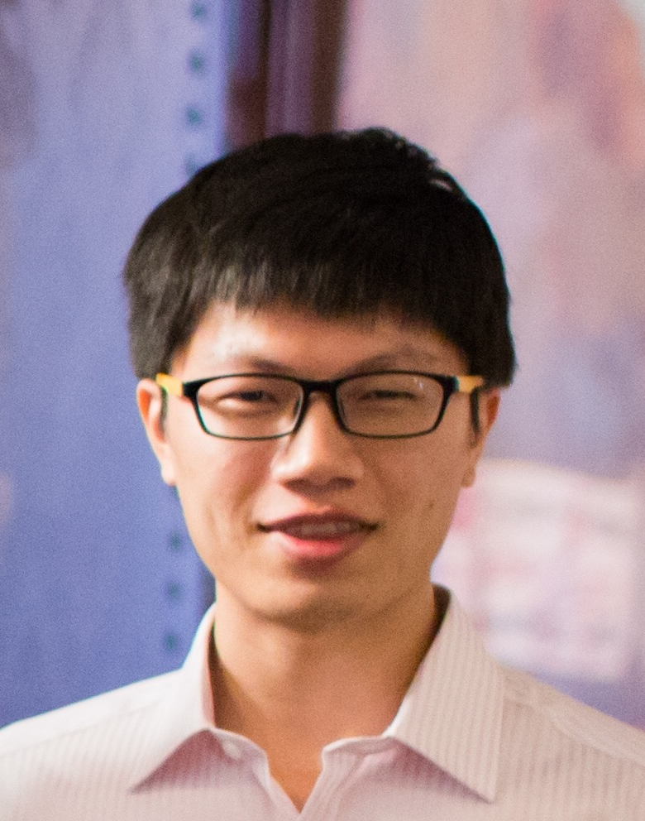
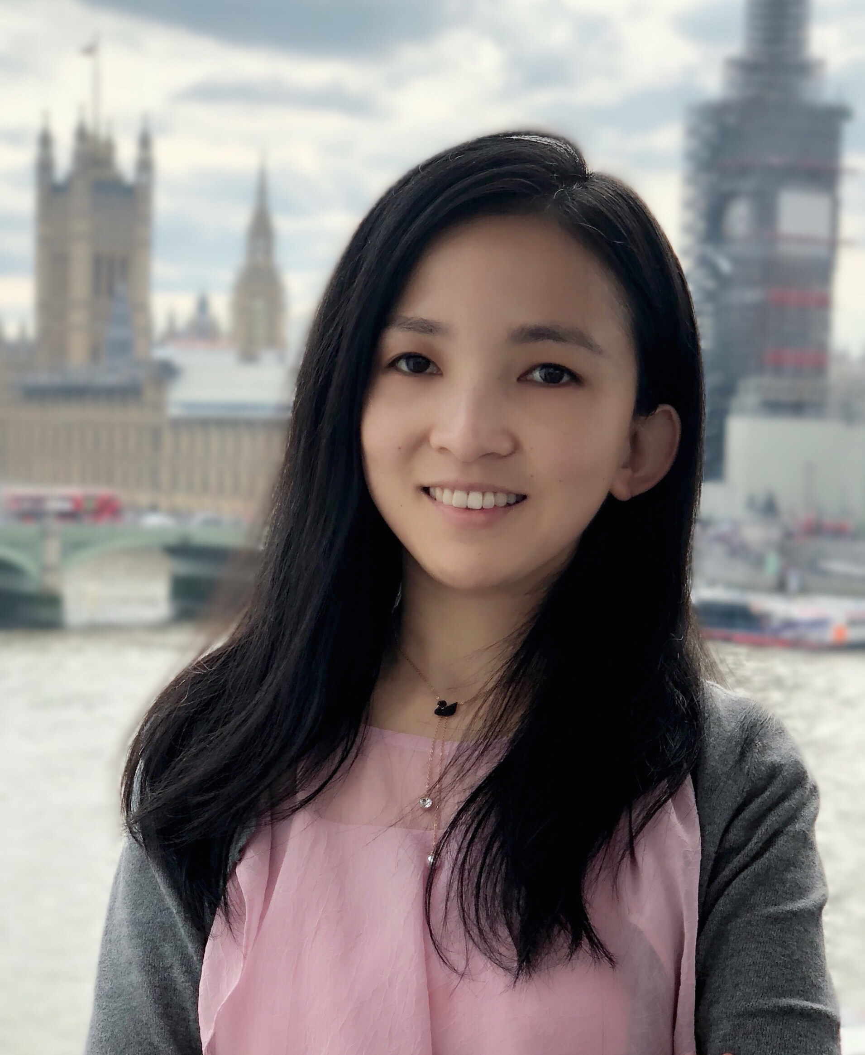
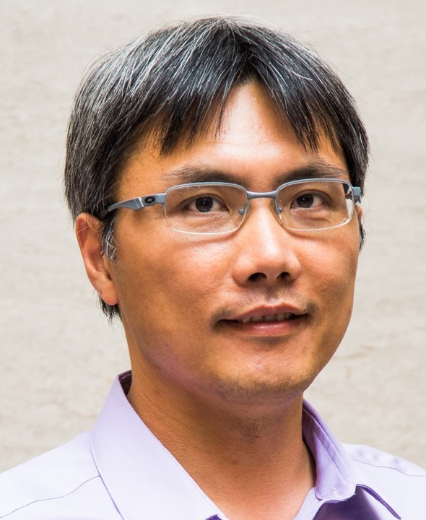
Ahmed Hassan Awadallah
Microsoft Research
Yu Su
The Ohio State University
Microsoft Semantic Machines
Huan Sun
The Ohio State University
Scott Wen-tau Yih
Facebook AI Research

